Slide 1

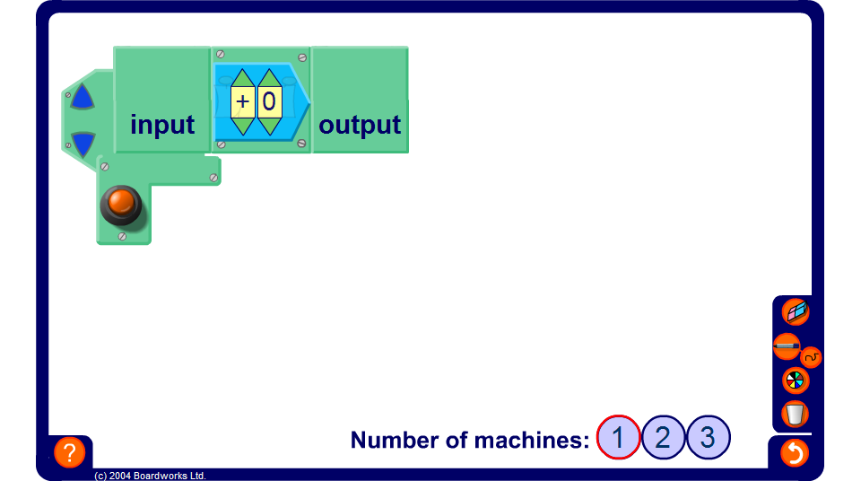


Finding outputs given inputs
Notes:
Start with one machine to demonstrate to pupils how the function machine works. Explain that a number is fed into the machine (this is the input), the machine performs an operation (or series of operations) on the number to produce the output.
Change the number of machines and use the function editor to create a given chain of functions. Hide the output before pressing the orange button. Change the input and ask pupils to find the output.
If required you can show the intermediate steps.

